Slide 1
Good morning.
It’s truly an honor to be here with you today.
How amazing to be in this historic Reagan Library and here amongst those of us who work in supply chain and risk management.
Thank you to the organizers for having me – how truly humbling to be part of such an an inspirational event.
Again, thank you for this opportunity to speak with you and your attention.

Slide 2
Iron Curtain – Digital Curtain
Almost 74 years ago, Winston Churchill gave a sobering speech at Westminster College in Missouri in 1946
”An iron curtain has descended across the continent.”
Churchill was prescient. His off handed comment became the metaphor for foreign policy 1946 to 1991.
The appropriate metaphor for China still needs to be found.
We’re seeing the shades of this in how trade has been weaponized

Slide 3
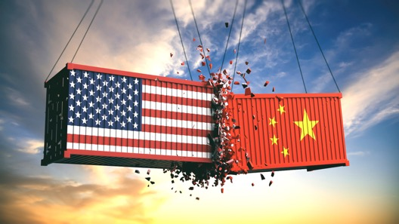
Source: Shutterstock
Source: WHO
Trade War
Coronavirus
COVID - 19
Greg Hutchins PE CERM
Quality + Engineering
GregH@800Compete.com
503.233.1012 or 800.COMPETE

Slide 4
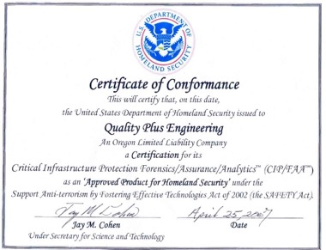
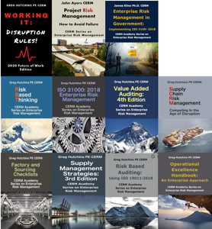
Greg Hutchins PE CERM?
Engineer
Author of more than 30 books including Supply Chain Risk Management
First company to be DHS approved for
CIP Forensics, Assurance, Analytics®
Been involved in global trade for more than 30 years
Grew up in Asia
Founder of:
800Compete.com
WorkingIt.com
CERMAcademy.com
QualityPlusEngineering.com

Slide 5
Presentation Questions
What risks does COVID – 19 present?
Why does this question matter?
What’s the critical question for all companies sourcing in China?
What are sourcing options?
What’s the future of US/China relations?
Source: Center for Disease Control

Slide 6
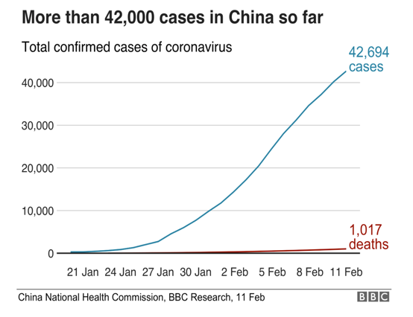
1. COVID 19 Risks
Context is worth 20 IQ points
We are at an inflection point in:
Global health
Trade
Geo-politics
Geo-economics
Words can’t adequately describe :
“Catastrophic”
“Existential threat”
“Unprecedented”
“New normal”
“Scary

Slide 7
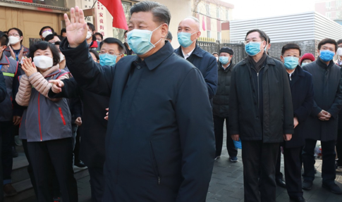
Times & Rules They Are A’Changing
COVID 19 is a game changer
Worldwide epidemic shows how quickly events can change business models
This is exactly what is happening with today’s topic trade, supply chain management and changing assumptions
Dynamic environment and asymmetric risks
Business and government face questions and quandaries not addressed before?
Source: Xinhua

Slide 8
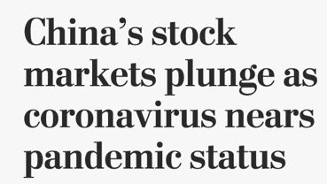
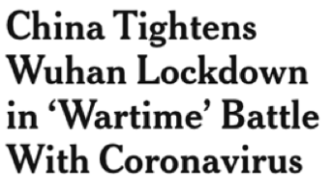
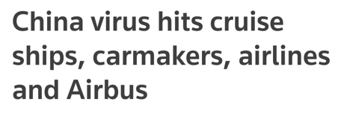
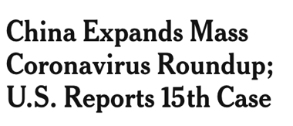

Slide 9
Coronavirus Consequences in China Are Real
“I am in Hong Kong, where they closed the border with China at midnight (Feb 3), barring a few crossings such as the sea bridge with Macau and Zhuhai.
Everyone here is working from home, the streets are quiet and the docks are even more so. In Hong Kong, freight forwarders are twiddling their thumbs as the Chinese market is on effective shutdown.
Factories have been shut since before Lunar New Year and will remain closed until at least February 10 in 14 provinces that cover 70% of GDP and 80% of exports.
It's too early to see concrete downstream impact, but with borders being shut to Chinese travelers, air cargo flights being cancelled and no workers in Chinese factories to make the inputs for use in manufacturing in Southeast Asia, it is a matter of time.
I spoke with one manufacturer in Thailand this morning who has enough inventory to stock the next order, then he doesn't know what he can do, since he needs parts (and talent) from China.”
Source: Twitter
Finbarr Bermingham South China Morning Post
Production Editor
Political Economy Hong Kong

Slide 10
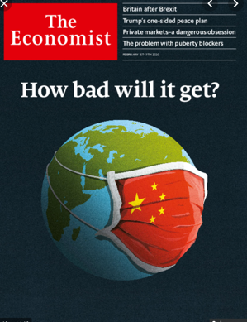
2. Why Does This Matter?
Let’s do an experiment. Pick up local paper.
What is the common lens for most of the articles and news?
What percentage of articles deal with risk?
Welcome to the world of disruption & uncertainty
Let’s look at global, business, and people impacts and risks
Source: The Economist

Slide 11
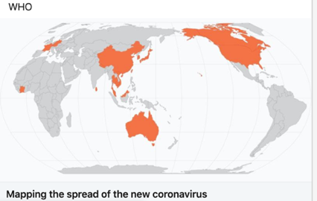
Global Risks
Coronavirus risks
People risks
Geo-economic risks
Geo-economic risks
Impacts:
‘Do Not Enter’ Signs in US, Australia, etc.
Quarantines
New business models
Source: WHO
Source: Pixabay

Slide 12
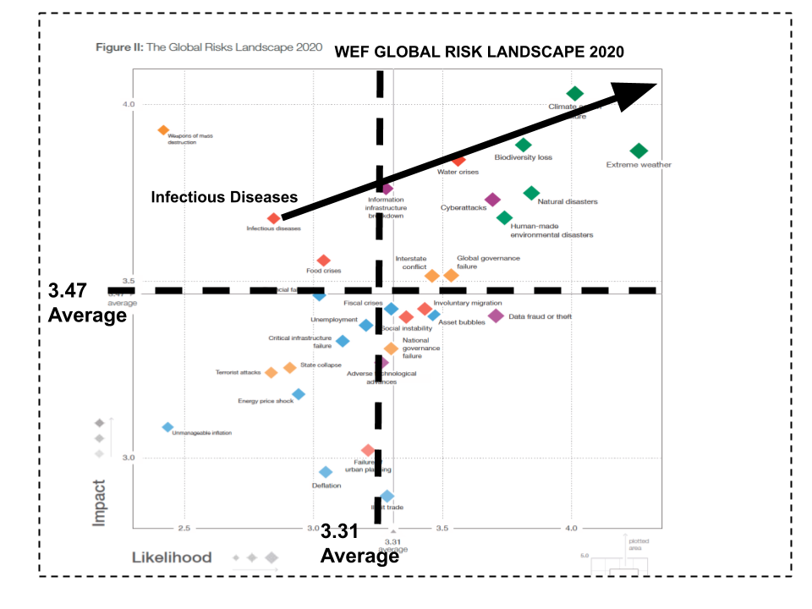
Coronavirus Risks

Slide 13
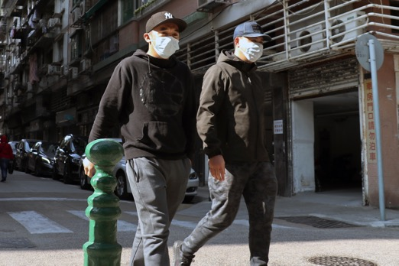
People Risks
Public Safety: 45 million people in China quarantined
Shanghai & Beijing may be next
Chinese cities isolated
Some cities are 3 times bigger than London
Global health emergency
WHO may determine pandemic
Source: Macau Photo Agency

Slide 14
Geo-Political Risks
Old Engagement Rules
New Engagement Rules
Geo-economic and geo-political co-operation
Military expansion
Friendly competition
Free trade
World wide job creation
Made In China
Geo-economic and geo-political confrontations and containment
Tech warfare with information AI, 5G, IOT, surveillance, cyber. etc
Rise of the Digital Curtain
Continuous trade wars
Domestic job creation
Made in USA

Slide 15
Geo-Economic Risks
Old Engagement Rules
New Engagement Rules
Buy (Source)
Single source in China
Just in Time delivery
Lean manufacturing
Offshoring
Mechanical products
Supplier evaluation
Quality focus
Made in USA
Sourced in multiple countries
Just in Case contingencies
Buffer inventories
Near or on shoring
Products + Embedded software
Supplier forensic evaluation
Risk focus

Slide 16
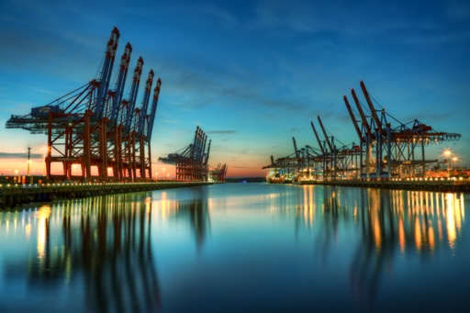
3. Trade & Sourcing Risks
Trade deficit 2018 with China = $419 B
Trade deficit 2019 with China = $346 B
One year ago, we would have said that US - China trade differences were negotiable
Both sides were talking, positioning, posturing, and negotiating
Fundamental shift in sourcing to China
Trade and sourcing have been “weaponized”
It’s all about domestic high - paying jobs – Senator Schumer (D) is hardliner
Source: Shutterstock

Slide 17
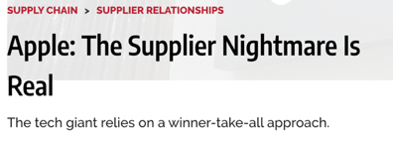
Business Risks: Apple’s Story
Apple has a market capitalization of $1 Trillion. Most of its revenue and margins are from iPhone.
“Virtually all of the world’s iPhones are Made in China.”
“I can’t imagine a scenario where the supply chain isn’t disrupted” … “If there’s one major hiccup in the raw materials, fabrication, assembly, test, and shipping, it will be a disruption.”
Source: Bloomberg, January 27, 2020
The risk here is obvious.
Source: Apple
Source: 9to5Mac.com 2/10/20
Source: Industry Week 2/10/20

Slide 18
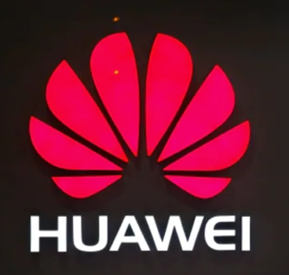
Chinese Covert Risks: Huawei’s Story
Huawei is a Chinese state-funded communications firm
Sells 200 million smart phone in 2019
Huawei provides products and software for critical infrastructure
If this a real threat? Yes!!
Is the fear real? Yes!!
Source: Huawei
Source: WSJ, 2/12/20

Slide 19
China - Great Decision - World Class Sourcing
Ten Years Ago
Now
Manufacturability – World class/Robotic/AI/IOT
OP Ex Practices – Lean, Six Sigma
Technology/Design - World class
Quality – Cpk – 2.0 or PPM
Product delivery – Just-in-Time
Cost – 10% lower or higher
Manufacturability - ISO 9001 certified
Op Ex Practices – First article, SPC
Technology/Design – Acceptable
Quality - Cpk - 1.0, compliance
Product delivery – Within acceptable windows
Cost – 40% or more lower

Slide 20
But - China Sourcing Risks Are Increasing
Weaponized trade
Asymmetric warfare – i.e. Chinese cyber attacks
Nationalist politics (made in China, USA, etc.)
Chinese & US politics
Supply chains as pawns in a global struggles
Unintended consequences
Black Swans -Coronavirus
Known, unknown events
Tariffs – 25% game changer
IP loss
Lack of access domestic markets
Confused and changing sourcing rules
Embedded malware in products (IOT/com/etc)
Source: Pixabay

Slide 21
Pivotal Time: Re-evaluate Business Models
Current Model
Re-evaluation of Model
Manage brand
Outsource product design
Outsource manufacturing
(Up to 80% of value)
Test products (externally)
Sell products
Secure brand & IP
Design product (retain control)
Re-evaluate ‘make or buy’
Test products (internally)
Sell products (equivalency)

Slide 22
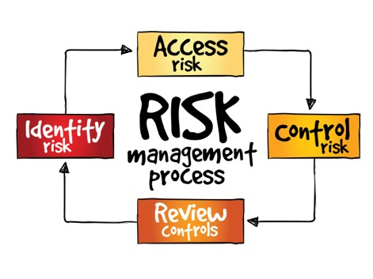
Risk Based, Decision Making
The Challenge:
“… , it is questionable whether fragile globalized supply chains can thrive at all in an environment where the world’s two largest economies are disinclined to play by the rules, even their own.”
Wall Street Journal, December 13, 2018
Responses:
Risk (Threats) are much higher due to coronavirus etc.
Result: Brand companies are re-evaluating sourcing models and ‘make or buy’ decisions based on risk
Source: Shutterstock

Slide 23
Critical Question: 'Make or Buy’ Decision
Can a U.S. company withstand loss of parts from Chinese major supplier for four or six months?
NO!!!!
So, what’s the solution:
Revisit business assumptions made 20 or even 30 years ago
Revisit ‘Make or Buy’ Decisions for each China sourced product
Business continuity was based on fire or work disruption, not shutdown of China’s economy
Chinese disruptions are continuous
Source: Shutterstock

Slide 24
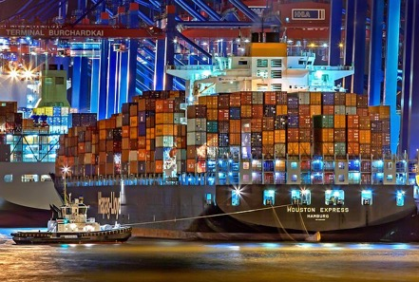
4. Sourcing Risk Strategies
Accept sourcing risks
Diversify sourcing risks
Share sourcing risks
Control sourcing risks
Assumption: Each sourcing category is risk evaluated and mitigated separately
i.e. Chinese commodity supplier is evaluated differently that tech supplier with embedded software
Source: Pixabay

Slide 25
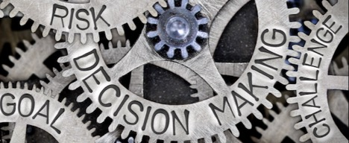
Accept Chinese Sourcing Risks
Re-evaluate internal business and sourcing models
Bilateral economic concessions
Reprice products to domestic customers
Pass along costs along supply chain (T1, T2, etc)
Change China sourcing risk tolerance
Source from China commodity products
Insource high risk/value products
Game tariff system (i.e. transship)
Source: Shutterstock

Slide 26
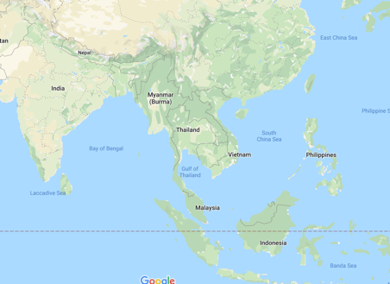
Diversify Chinese Sourcing Risks
Develop new supplier risk assurance methods
Develop multiple sourcing options
Develop prime domestic supplier/ acceptable offshore alternative
Find new suppliers in Asia (Vietnam)
Make product in house
“Just in case” NOT “just in time” delivery
Carry additional buffer inventories
Source: Google Maps

Slide 27
Share Chinese Sourcing Risks
Share tariff costs between OEM with 1st tier suppliers
Cascade supply cost sharing
Source disruption insurance
Bring IP & design in house
Impose higher product and cost requirements on suppliers
Retain single and acceptable alternate suppliers
Source in multiple countries
Add further requirements on supplier
Source: NZ Defemse

Slide 28
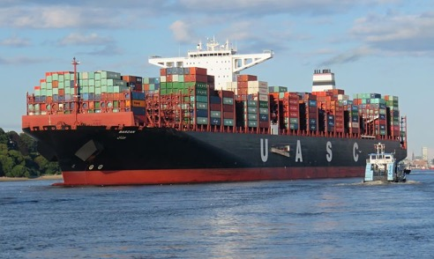
Control Chinese Sourcing Risks
Re-evaluate ‘make or buy’ risk decision
Re-evaluate suppliers based on risk
Add further supplier controls
Conduct forensic supplier audits
Add Internet Of Things product testing (i.e. reliability , software)
Source: Pixabay

Slide 29
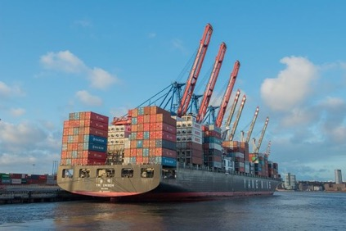
Control Chinese Sourcing Risks
Add IP agreements with suppliers
Obtain source code for embedded software
Push OEM requirements to sub-tier suppliers
Ensure product traceability of suppliers (2nd tier etc.)
Provide chain of assurance and risk - controls to OEM
Source: Pixabay

Slide 30
5. Future of US/China Sourcing and Relations
“In short - after a year from hell during which the trade war, Hong Kong's protests, and an international clamor against the persecutions in Xinjiang (Ethnic) blotted the Communist Chinese Party’s (CCP) copybook in the eyes of many domestically, this is the last thing China needed. It is expected that the economic impact will be enormous.”
Source: Twitter
Finbarr Bermingham Production Editor, Political Economy Hong Kong

Slide 31
Short Term Scenarios
China
U.S.
More quarantines
More human and product testing
Factory closures
Logistics bottlenecks
Disrupted supply chains
Return factories to production
Drastically reduced factory output
Suspension of flights and ships
4% GDP in 2020
Continue to use Chinese suppliers
US factory closures due to lack of parts
Scramble for alternate sourcing in Asia and worldwide
Review of current business and sourcing models
Review domestic sourcing options
Readjust product plans & schedules
2.2% GDP in 2020

Slide 32
Long Term Scenarios
China
U.S
Manifest Destiny – Belt and Road
Asymmetric war via weaponized trade, global infrastructure investment
Artificial intelligence
Increased surveillance & control
EU, China, USA, India, GCC, and major trading blocs wage trade war
Domestic consumption and build out
Digital curtain
Government prosecution of IP theft and individual theft
Artificial intelligence
Review and develop new sourcing strategies based on enterprise risk
Develop new investment plant strategies
Trade ‘equivalence’ - access to markets/amount of trade

Slide 33
Long Term Sourcing Strategies
China
U.S.
Sourcing is perceived as power, competitiveness and jobs issues
Massive state investment in companies
‘Made in China’ brand management
Focus on domestic consumption
Select and certify new suppliers
Develop new rules of sourcing engagement
End product manufacturers will weigh ‘make or buy’ through risk lens
Forensic evaluation of suppliers and sourcing decisions

Slide 34
Outcomes – U. S. Perspective
“I don’t want to talk about a victory lap over a very unfortunate, very malignant disease. But the fact is, it does give businesses another thing to consider when they go through their review of their supply chain.”
Coronavirus is “another risk factor that people need to take into account. ″I think it will help to accelerate the return of jobs to North America. Some to the U.S., some to Mexico as well.”
Source: USA.gov
Wilbur Ross, U.S. Secretary of Commerce

Slide 35
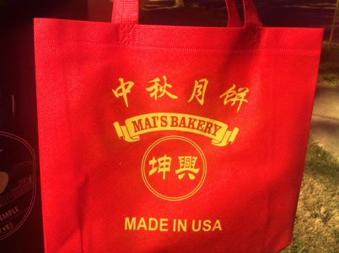
Outcome: Metaphor for Chinese Relations?
Trade war in one picture
Mai’s Bakery
Portland, Oregon, USA
Sells Chinese baked goods
Plastic bag to carry hum bao etc.
MADE IN THE USA logo

Slide 36
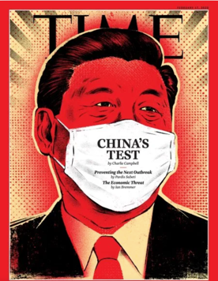
We Don’t Know What We Don’t Know!!!!
Uncharted territory
Coronavirus is a Black Swan
Political, economic, business & people unintended consequences
Don’t have the vocabulary
Don’t know the rules of engagement or even words
to properly describe
Rules and norms have
changed
Source: Time Magazine

Slide 37
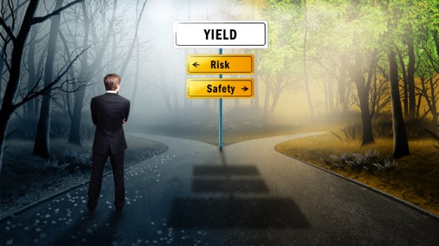
Thank you for this opportunity to speak to you and your attention.
Any thoughts or comments would greatly be appreciated?
Source: Shutterstock

Slide 40
What To Do?

Slide 41
Risk Reporting
Risks to companies sourcing to China
PR – Hong Kong
Tariffs
Tradewar
Huawei
Coronovirus
Public listed companies must report risks in 10Q’s and 10K’s.
Investor community wants to know how sourcing companies will mitigate an controls risks.

Slide 42
Interesting Thing Happened Over Last 10 Years
End product manufacturer is not buying products or services, it’s securing the supplier processes, integrating them with it’s own, and at a higher level acquiring the supplier’s IP

Slide 43
Wny Do I Use the Term ‘Rules of Engagement’?
Weaponizing trade like US and China is new.
Communications and expectations are changing
Importance of context defining the new relationships with trading countries and partners
Davos meeting was last month. One of the biggest discussopn was uture of work.

Slide 44
Source: Shutterstock
Source: WHO
Trade War
Coronavirus
COVID - 19
Greg Hutchins PE CERM
Quality + Engineering
GregH@800Compete.com
503.233.1012 or 800.COMPETE

